Slide 1
Mission Lakes Association Annual Meeting
May 27th, 2023
Mission Park Pavilion

Slide 2
Agenda
Coffee and donuts/social time
Welcome
Board Introductions
Mission Lakes Association Business Meeting
Financials
Family/Community-based events
Fisheries/Water Quality
Member Business
Break
Lake Improvement District
Overview
Q and A
Comments – 2 minutes per person
Notes:
Thank Barb Woese for setting up coffee and donuts.

Slide 3
Memorial Day… a day of remembrance & honor…
In memory of many, in honor of all,
Thank you.

Slide 4
Introductions – our Board Members
Nick Bernier – President Emeritus
Steve Pittman – Vice President
Gail Nixa - Treasurer
Palma Zoia – Secretary
Lake Representatives
Geoff Zastrow
Ice Fish’N Event ‘aficionado’
Bruce Addleman
Water Quality captain
Mark Casey
‘Mission Bell’ creator
Recognize & thank Jack Schubert, a long time board member.

Slide 5
Financials – Gail Nixa, Treasurer
Notes:
Gail was not able to attend annual meeting or provide financials due to family needs

Slide 6
2022 Income/Expense by Category (Jan – Dec, 2022)
EXPENSES
Curlyleaf Treatment 8800.00
EWM Treatment 16,575.00
Lake Survey 1000.00
LID application 500.00
Meeting Expense 96.00
Membership 200.00
Newsletter Expense 2690.26
PO Box 62.00
Postage 451.15
Printing 42.21
Software 111.66
Water testing 768.00
Website 349.98
TOTAL EXPENSES 29,444.26
INCOME
Contributions 22,105.07
Crow Wing County Reimb 5000.00
Interest Inc Savings 2.18
Interest Income checking 7.97
Member Dues 2478.24
State Aid AIS Funding 2250.00
From Unspecified Account 453.68
TOTAL INCOME 32,297.14
Balance 2,852.88

Slide 7
Mission Lakes Association
To keep our lakes:
Fishable
Navigable
Swimmable
Naturally beautiful
Increase engagement and provide education for all lakeshore owners and members
Notes:
Objectives created from input/feedback from attendees at Sept 2021 annual meeting, door to door ‘contact’ campaign – Sept 2021

Slide 8
Improve Communications
Improve Communications
E-Mail campaign (> 185 email addresses)
missionlakesmn@gmail.com
Newsletters –The Mission Bell
Mailed out 2X per year to all lakeshore owners,
Not just association members
Website
www.missionlakesassociation.org

Slide 9
Improve Communications Help Us
Provide us with your email address
Key stakeholders husband & wife, partners, dual owners
Email us at missionlakesmn@gmail.com
“Spam prevention”
Check your email spam folder
About 10% of emails are returned to us as undeliverable

Slide 10
Communications – Mission Bell Newsletter
Mailed out 2 times/year to all lakeshore owners
Inform and educate
Key component for membership drive/donations
Strongly urged to continue mailing
Non-technical residents
Despite cost of printing/collating/mailing
Average cost = $2216/year (past 2 years)
2022 - $250 educational grants/lake no longer available.
Loss of $500 per year to offset costs
Notes:
Average Cost of printing/mailing 2x/yr over the past 2 years = $2216 per year for 2 Newsletters per year

Slide 11
The Mission Bell

Slide 12
Communications – Website www.missionlakesassociation.org
Re-established our domain name!
Share lakeshore information & updates
Renew membership/donate on-line
Register for events
Share our history/newsletters/board meeting minutes
Notes:
Mission Lakes Logo Wear – Red Threads

Slide 13
missionlakesassociation.org
Notes:
Home page of our missionlakes website…

Slide 14
missionlakesassociation.org
Notes:
Register and pay for events

Slide 15
missionlakesassociation.org
Notes:
Key links to DNR website, and county websites…

Slide 16
2022 MLA Survey - December
49 returned out of 286 Surveys mailed, 48 members/1 non-member
42% Attended at least 1 MLA meeting, 38% annual meeting
58% participated in a social event, 40% boat parade
8 suggestions to add a picnic, pot luck or ice cream social
86% felt MLA does a good job communicating
88% received Mission Bell newsletter
52% visited website
75% don’t follow on Facebook

Slide 17
What we enjoy most about our lakes
52% Lake activities like boating, fishing, swimming etc.
38% Peace & Quiet, Serenity
32% Beauty, Sunsets, Trees and Wildlife
18% Friendly People/Neighbors

Slide 18
Lake Conditions Satisfaction
62% Somewhat, 28% Very
50% said Swimming is GOOD, 38% said IMPAIRED
80% said Fishing is GOOD or EXCELLENT
84% said Boating is GOOD or EXCELLENT
94% said Viewscape is GOOD or EXCELLENT
76% said Contribution to Property Value is GOOD or EXCELLENT

Slide 19
What would improve our enjoyment
46% Better Weed Control
50% said Continue Selective Treatment
38% said Get Rid of all AIS
18% Better Water Quality
50% welcomed Homeowner Education to reduce their impact on our lakes

Slide 20
Social/Family/Community-Based Events
‘Board & Breakfast’ – quarterly
Meet board/neighbors/exchange ideas
Quarterly – 1st meeting April 2022
Light Up the Lakes – evening of July 3rd
Door to door delivery of 3 luminaries for each family
Shoreline management info from county
Website/email notification, membership/donation request
4th of July Boat Parade
Decorate watercraft
2nd Annual Ice Fish’N Fun event – Feb 25th, 2023
Numerous donations from local business & neighbors
Fund raiser
50/50 drawing for Fish Stocking Fund
50/50 winner donated all proceeds back to MLA – thank you!
Notes:
Joe Berger – donated proceeds back to MLA

Slide 21
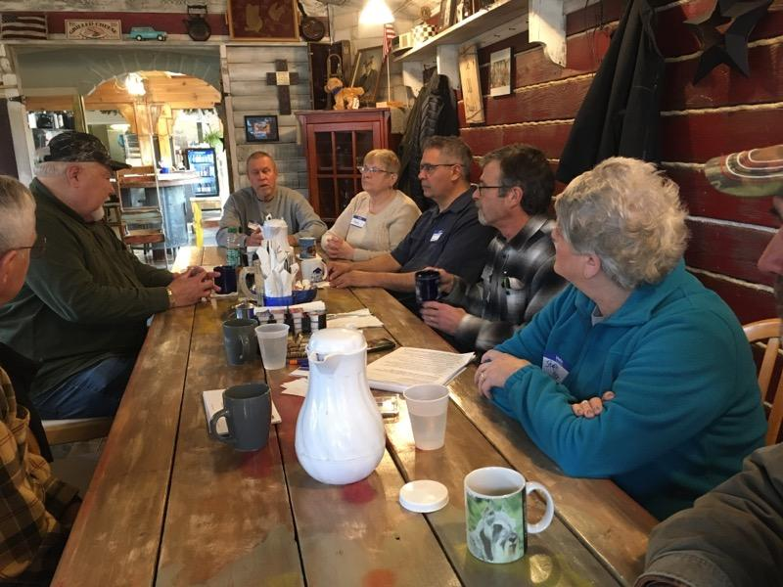
Board & Breakfast
Notes:
Announced on our website, emails sent out –opportunity to learn about the lake, meet your neighbors and board members and get a free cup of coffee

Slide 22
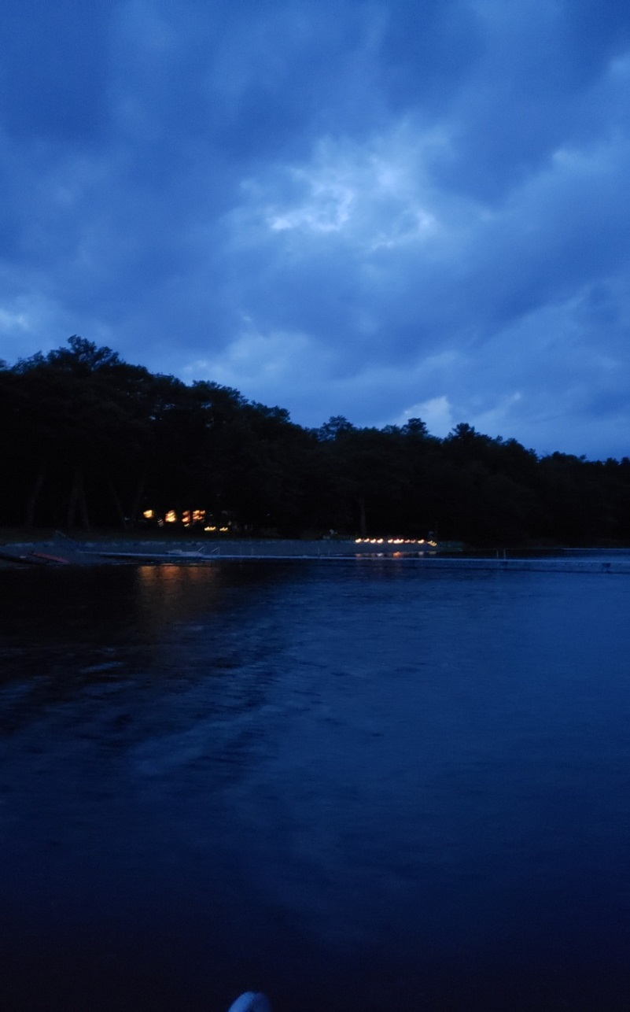
Family events – “Light up the Lakes”
*Anonymous donor,
no cost to MLA
Notes:
Volunteer efforts to hand deliver luminary kits to everyone on our lakes.

Slide 23
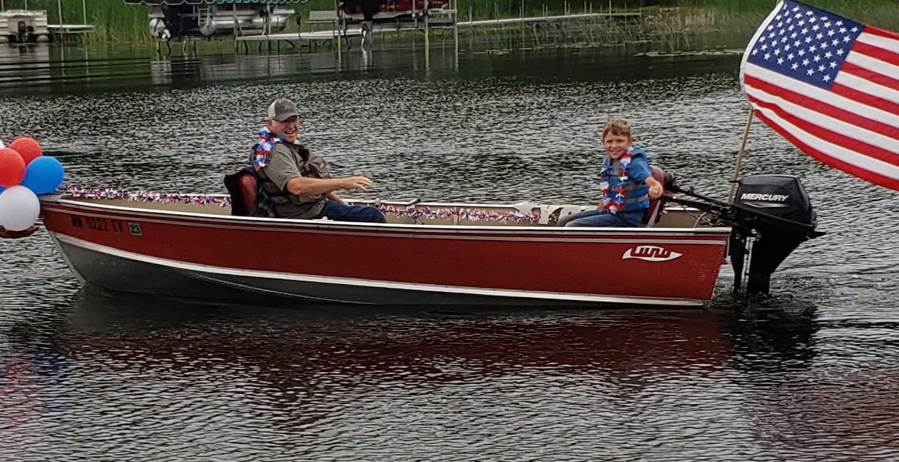
4th of July Boat Parade
Notes:
Only picked a few of the photos we got from the parade participants, but this is one of our favorites.

Slide 24
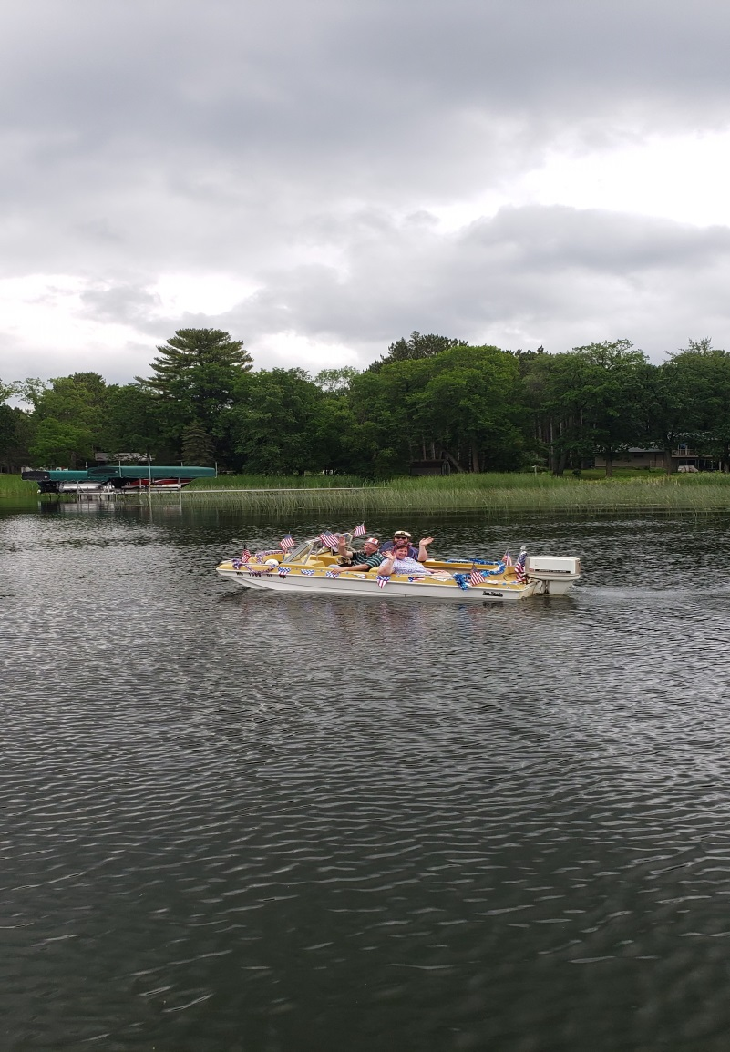
Family fun –creating memories
Notes:
So many more on our website…

Slide 25
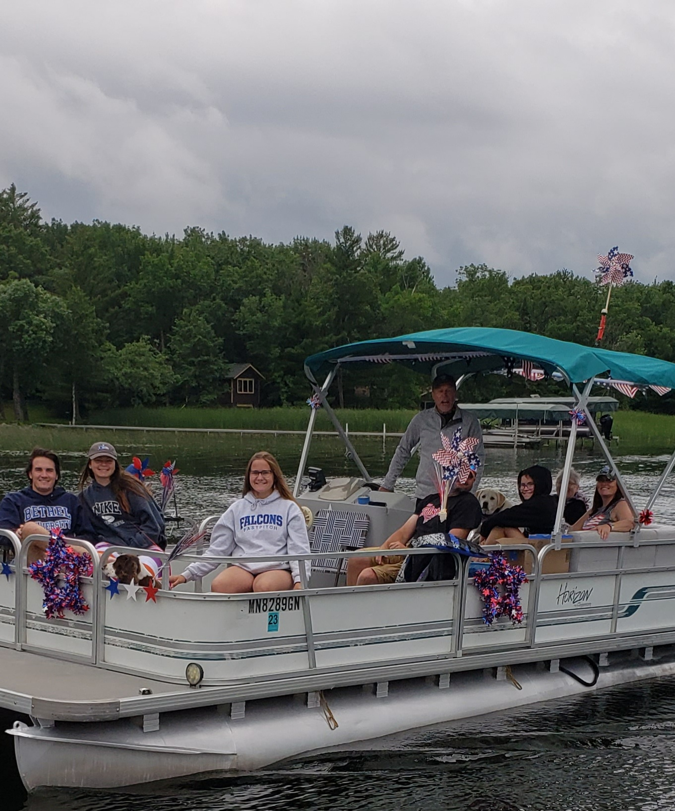
Family events

Slide 26
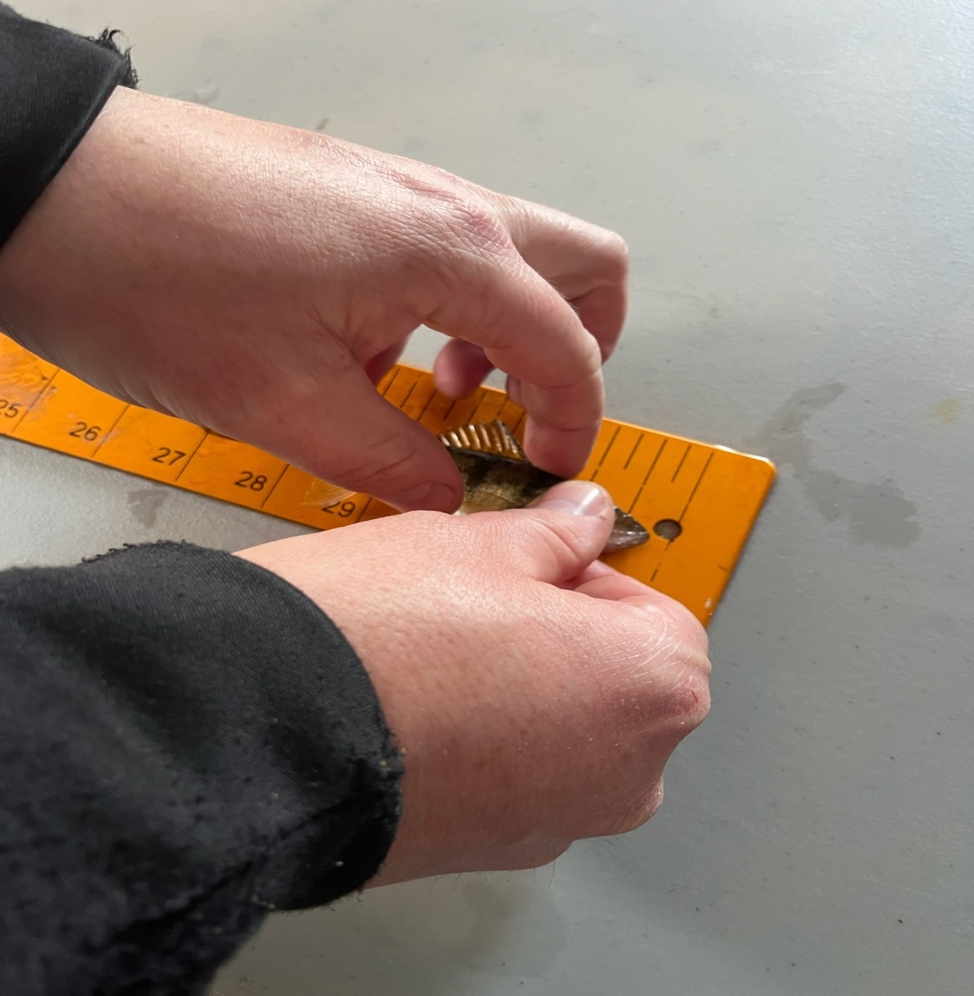
2nd Annual Ice Fish’N Event

Slide 27
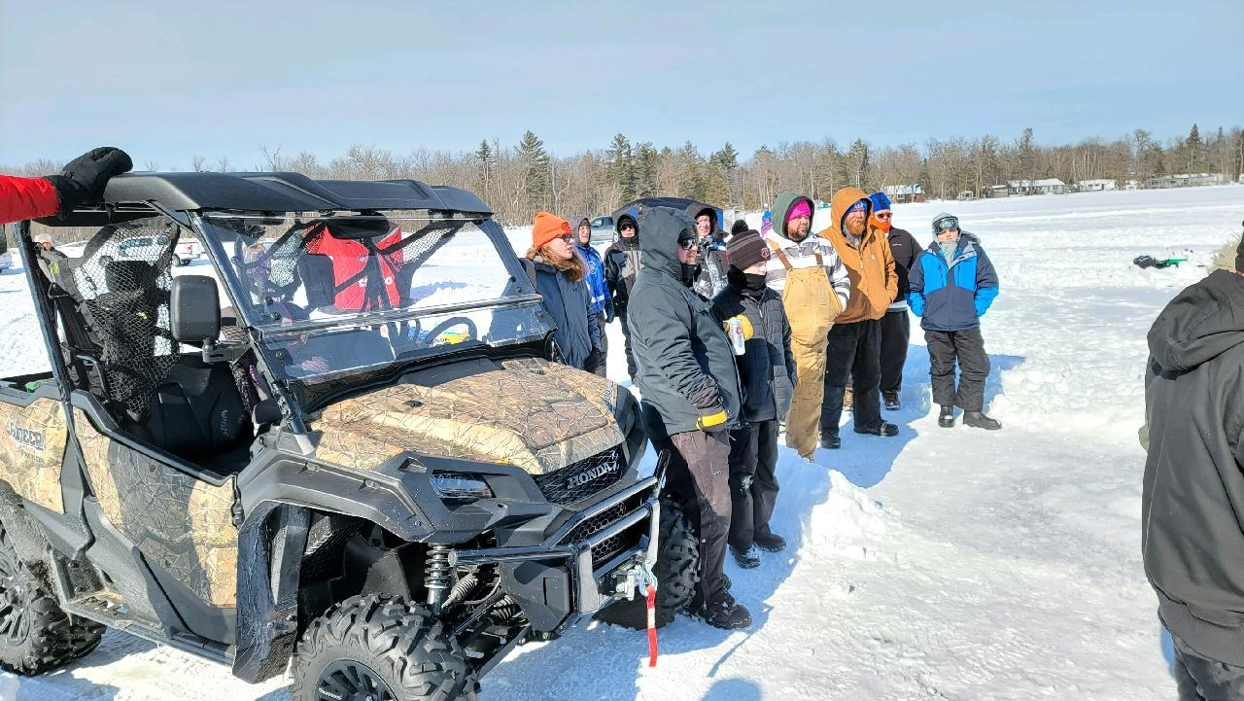
February 25th, 2023

Slide 28
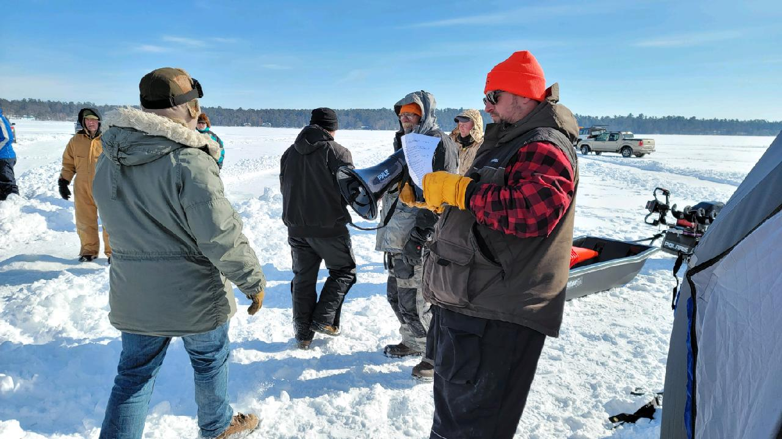
So many volunteers

Slide 29
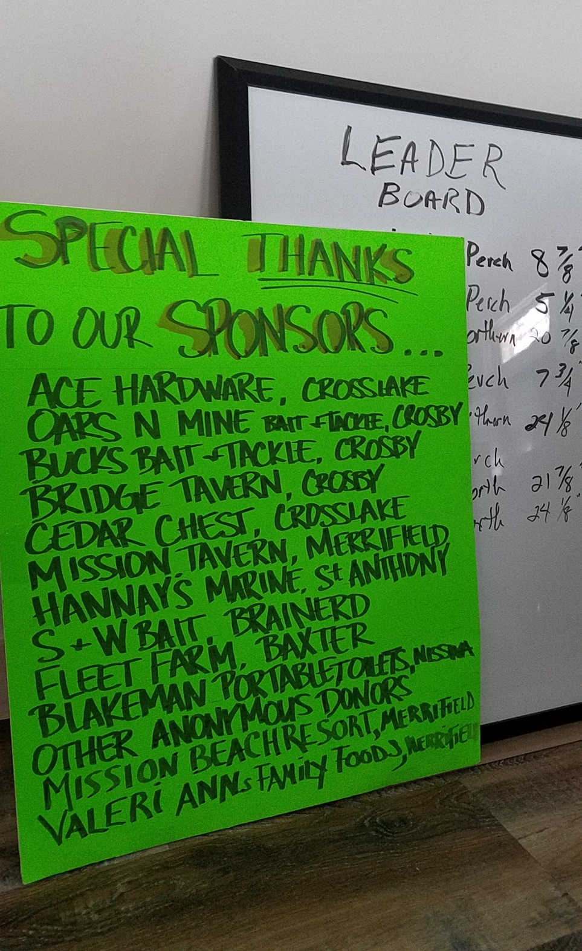
Local business support again this year !
Notes:
Incredible local sponsors

Slide 30
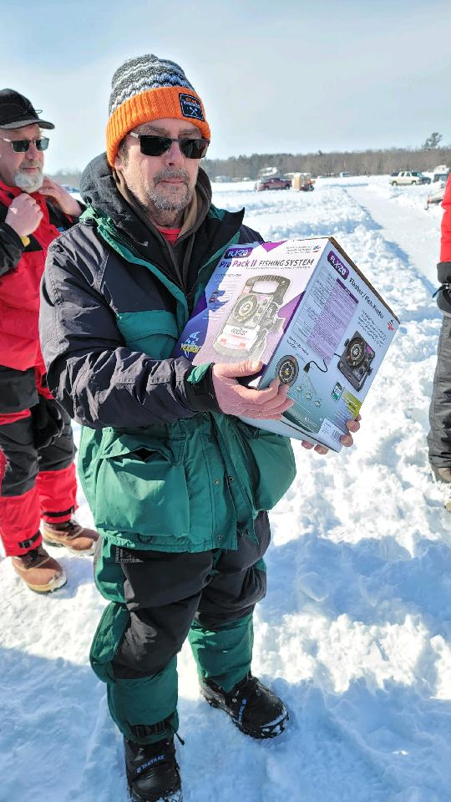
Lots of winners and amazing prizes
Notes:
Vexilar….from another new local donor this year Great Northern Paint & Pre-Finish

Slide 31
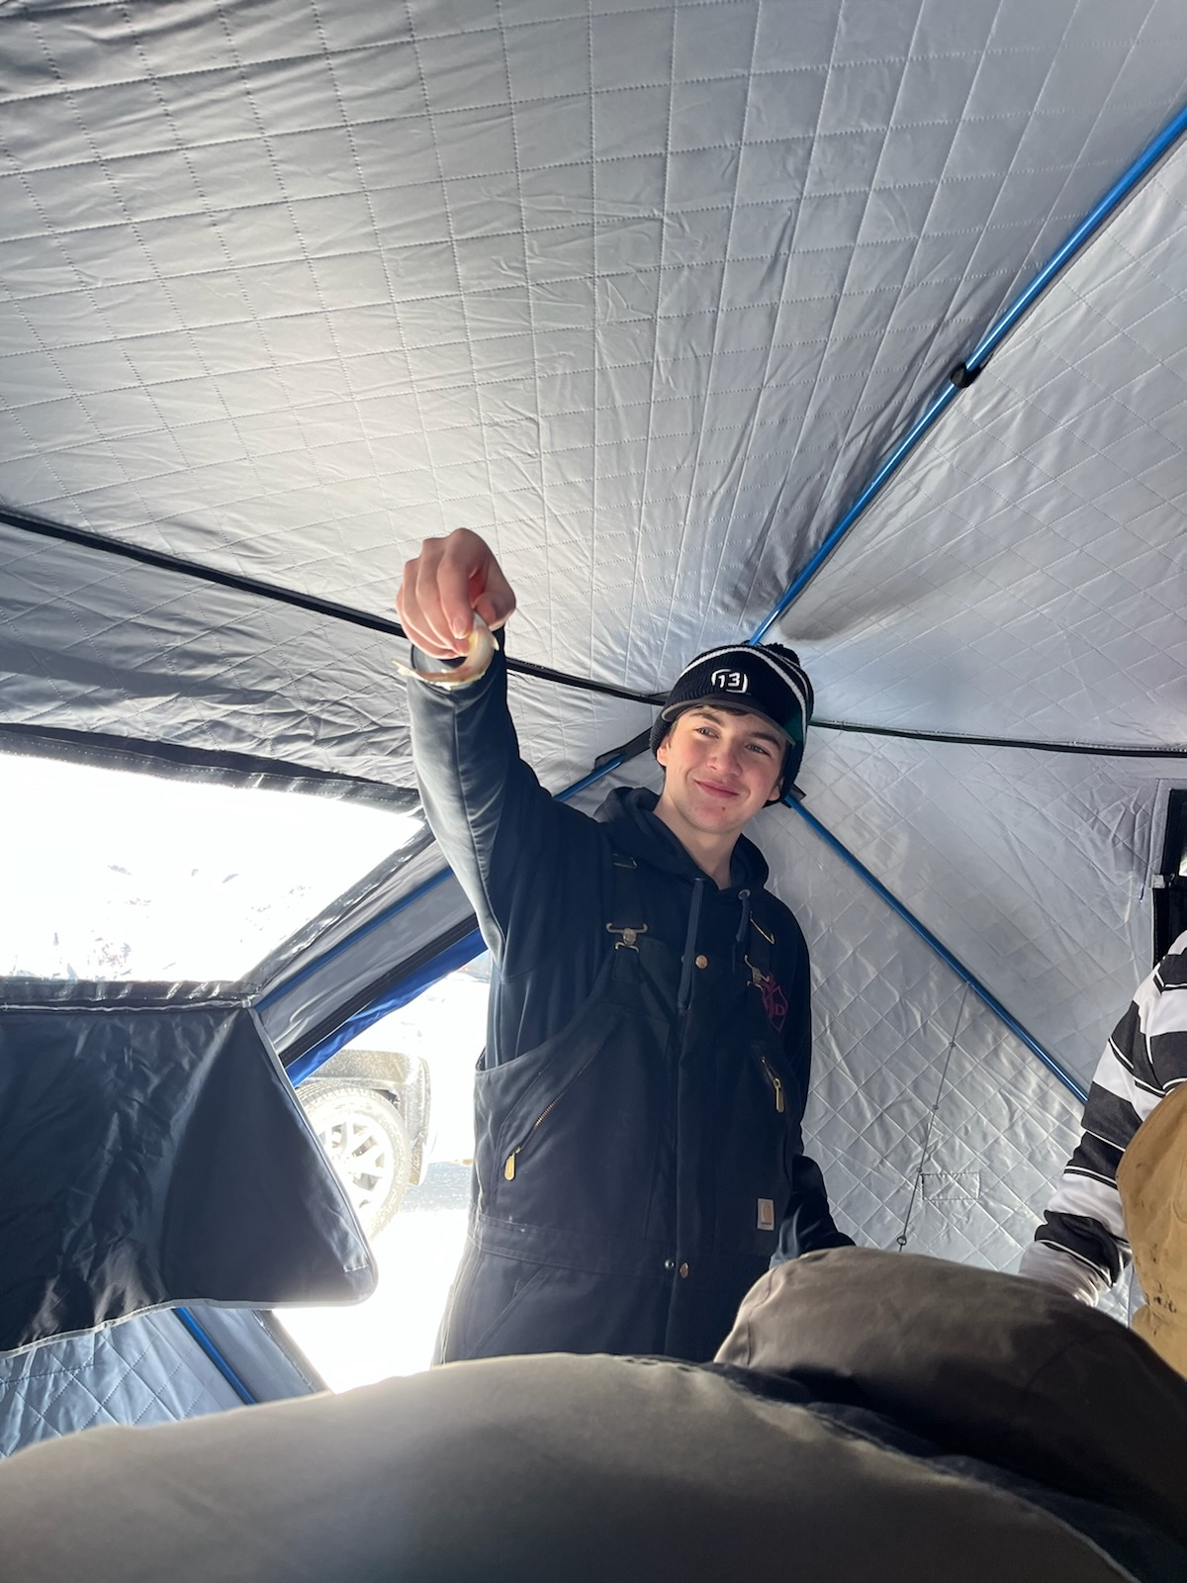
Kids of all ages

Slide 32
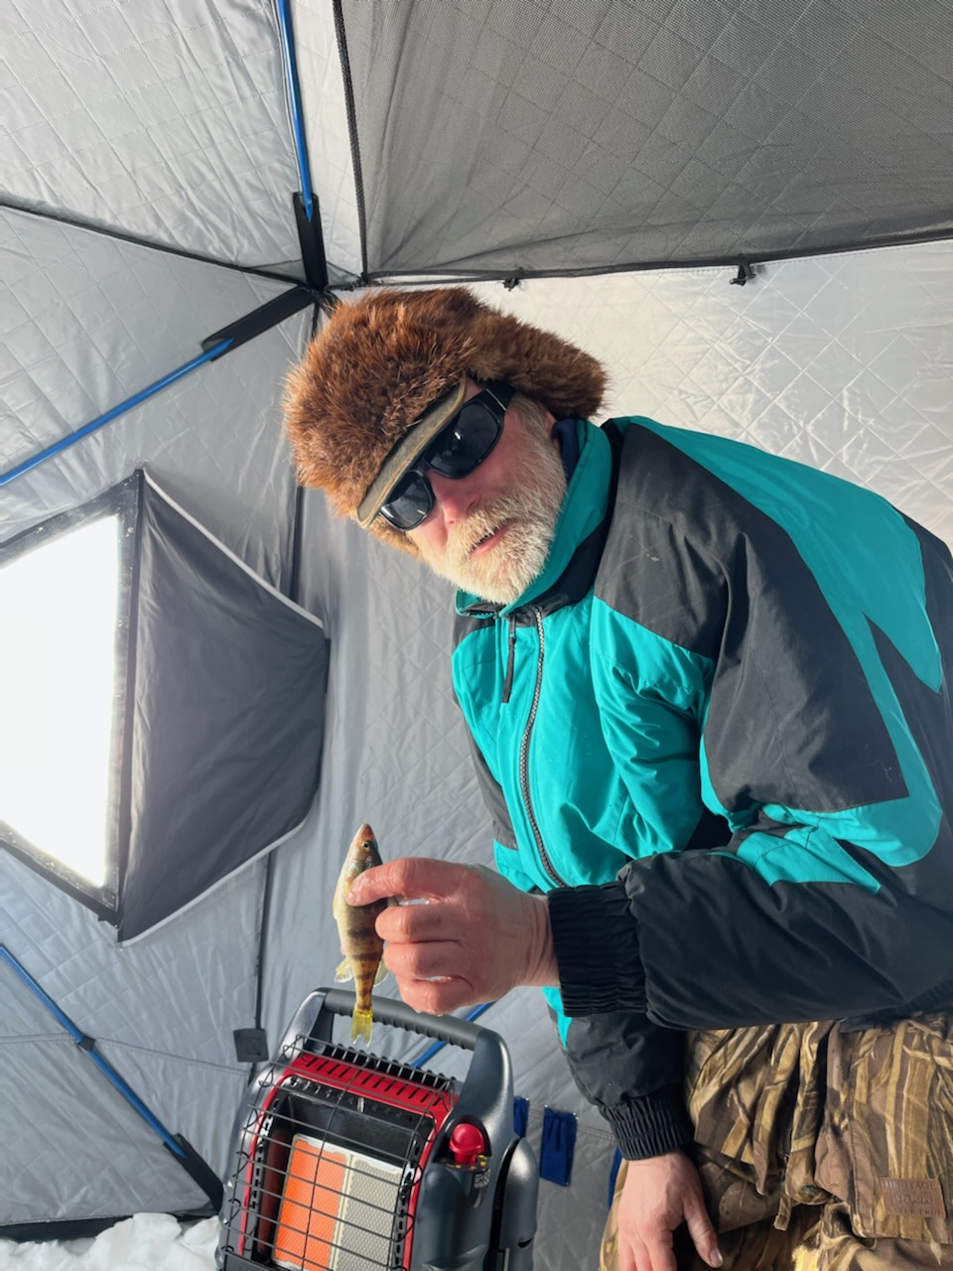
Possibly catching the same perch???

Slide 33
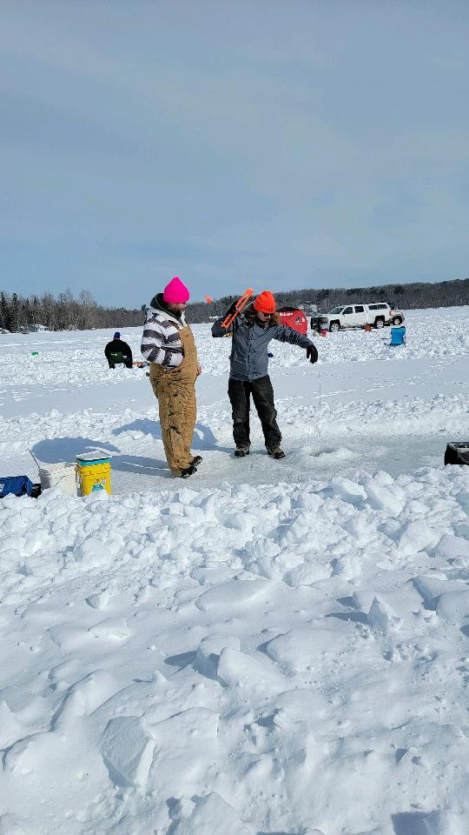
Tip-Ups

Slide 34
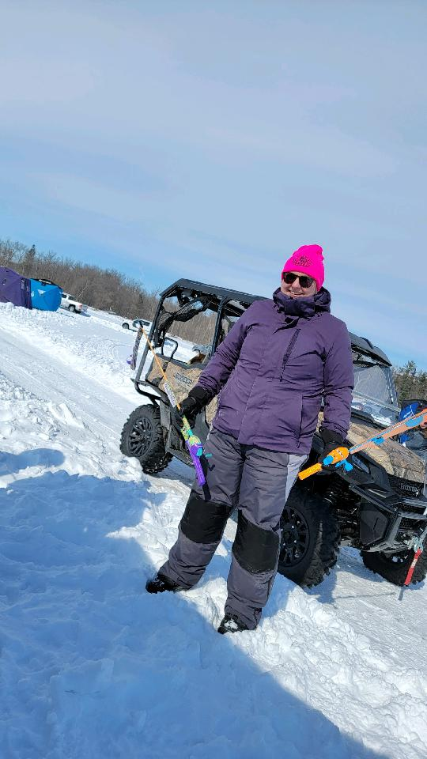
Big girl toys too

Slide 35
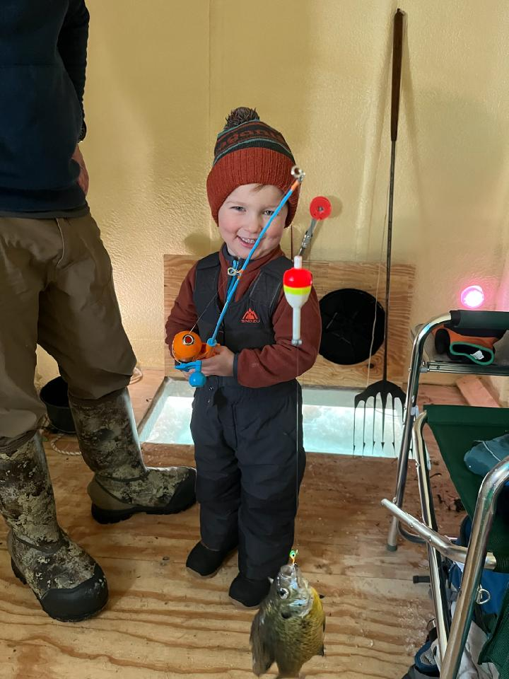
2nd Annual Ice FishNFun Event

Slide 36
Fisheries/Water Quality - DNR
DNR Updates
Secured Fish Survey in 2022
Due in 2020, didn’t happen due to Covid
Next survey scheduled for 2025
Board obtained commitment to complete survey in 2022
3 YEARS Earlier than originally scheduled
Provides us with measure of sustainability of our fisheries
Means to monitor the health of our lake

Slide 37
DNR Fish Survey – raw data & preliminary analysis
Northern Pike – a steady increase in numbers since 2004
Walleye – stable with a slight increase since 2004
Black Crappie – relatively stable but down from historic highs from 1956 to 2007
Blue Gill – slight improvement over 2014 but lower than historic averages of 1999 and prior years
Yellow Perch – relatively stable since 1999 and about average with other similar lakes.
Results are similar for both Upper and Lower Lakes.
Protected Northern slots and reduced pan fish limits are expected to improve the average size of Northern Pike and the number of pan fish however it is too early to know.
Notes:
Warned not to read too much into this until all the analysis is completed. General terms, based on # of fish only

Slide 38
missionlakesassociation.org
A formal analysis of the survey results will be available later in the year to the DNR Lake Finder site.
(http://www.missionlakesassociation.org has a link to the DNR Lake Finder site)

Slide 39
Fisheries/Water Quality - DNR
Supplemental Fish Stocking
DNR stocks biannually
Secured permission to supplement DNR fish stocking
To occur in Fall 2023
Ability to significantly supplement walleye fish stocking in our lakes
w/200# of Fingerlings = $4,000-$4,400
But we need additional funding…

Slide 40
Aquatic Invasive Species – Prevention
Crow Wing County
Mission Lakes – no county inspectors
Despite fishing pressure on our lakes.
Volunteer-only to date (Board Members)
Secured Lake Access Inspection Hours for both Upper and Lower Mission
Trained County Inspectors will educate/inspect for invasive species*
90 hours – 45 hours per lake
High traffic weekends including
Memorial Day
Labor Day
Need volunteers
* staff in process of being hired

Slide 41
Upper Mission Access
Notes:
Here’s why….fishing tournament held on both our lakes in 2022

Slide 42
Lower Mission Access

Slide 43
Horseshoe Lake Access
Notes:
Fishing tournament boats were at Horseshoe Lake, then came over to Mission Lakes. Horseshoe is infested with Zebra Mussels

Slide 44
Mission Lakes – Aquatic Invasive Species
Lower & Upper Mission
Curly Leaf Pondweed
Eurasian WaterMilfoil
Some Good News
No additional invasives identified to-date in Mission Lakes
However, we are “at risk”
Despite zebra mussels in neighboring lakes
Stony Stonewort – tending from north to south

Slide 45
Mission Lakes – Water Quality/Nutrients
CWC Land Services meeting
Lower Mission considered a shallow lake -
Higher level of internal loading of phosphates – promotes more growth
Where its coming from and what we can do
More Nutrients = More Weed Growth =More Decaying Biomass= More Nutrients= Green Water
Monitor Upper and Lower (May – Sept)
Chlorophyll , Phosphorus, and water clarity (Sechi disk)
indicator of long term health of lake
Solution; Reduce Nutrients entering the Lakes
Reduce Nutrients in the Lakes

Slide 46
Water Clarity –
Monitor Upper & Lower Mission
May – September
Secchi disk
Important indicator of lake health -shows amount of light penetration
New link available at Minnesota Pollution Control Agency
Webapp.pca.state.mn.us
Lake ID #s or type in name of lake
Lower Mission 18-0243-00-203
Upper Mission 18-0242-00-205
Notes:
Bruce Addleman & ochowski family????? Will work to post this link on our website

Slide 47
Water Quality- What we can do?
No Fertilizer
Get Septic Systems Pumped/Inspected
Recommendation every 3 years
Absorb & Store Nutrients
Capture or Redirect storm Run-off
gutters
Fire Pits ashes contain phosphorus; prevent them from reaching the lake
Leaves and grass clippings

Slide 48
Member Business
Lake Representative position available
2 year term
Motions to elect/affirm board
Motion to allow board to handle financial obligations consistent with goals and objectives of MLA.

Slide 49
Mission Lakes Association
Thanks You for your Interest and Support!
Become a Steward of our Lakes and it will
become a Legacy you can be Proud Of

Slide 50
Break – 10 minutes

Slide 51
2022 Mission Lakes Association (MLA) Survey
______________________________________
Rate the following regarding your use of our lakes. Circle one response for each.
Swimming – Excellent / Good / Impaired / Unacceptable
Fishing - Excellent / Good / Impaired / Unacceptable
Boating - Excellent / Good / Impaired / Unacceptable
“Viewscape” - Excellent / Good / Impaired / Unacceptable
Contribution to property value - Excellent / Good / Impaired / Unacceptable
MLA has only been selectively treating areas on our lakes with high concentration of Aquatic Invasive Species for many years. How do you feel about AIS and the herbicide treatment? Circle one.
Get rid of all AIS in our lakes
Continue selective herbicide treatment
Opposed to use of herbicides
Don’t bother as nature will take it’s own course
Would you be interested in learning about ways you can reduce your property’s impact on our lakes? YES / NO
The MLA board thanks you for your responses!
Are you a member of the MLA?
YES – How long have you been a member? _____
NO – What can we do to earn your support? _____________________________________________
Have you attended any of these 2022 MLA meetings? Circle meetings attended
Board & Breakfast – April
Annual Meeting – May
Board & Breakfast – October
Have you participated in any of these social events? Circle all that apply.
Ice Fishing Contest – February
Light up the lake – July 3rd
Boat parade – July 4th
What other kinds of social events should the MLA sponsor?
Do you feel the MLA does a good job of communicating with you? YES / NO
Do you receive the Mission Bell newsletter? YES / NO
Do you visit the MLA website (missionlakesassociation.org)? YES / NO
Do you follow the MLA Facebook page (Mission Lakes Association)? YES / NO
What do you enjoy most about our Mission Lakes? ______________________________________
What would improve your enjoyment of our Mission Lakes?
_____________________________________

Slide 52
2022 Mission Lakes Association (MLA) Survey
______________________________________
Rate the following regarding your use of our lakes. Circle one response for each.
Swimming – Excellent / Good / Impaired / Unacceptable
Fishing - Excellent / Good / Impaired / Unacceptable
Boating - Excellent / Good / Impaired / Unacceptable
“Viewscape” - Excellent / Good / Impaired / Unacceptable
Contribution to property value - Excellent / Good / Impaired / Unacceptable
MLA has only been selectively treating areas on our lakes with high concentration of Aquatic Invasive Species for many years. How do you feel about AIS and the herbicide treatment? Circle one.
Get rid of all AIS in our lakes
Continue selective herbicide treatment
Opposed to use of herbicides
Don’t bother as nature will take it’s own course
Would you be interested in learning about ways you can reduce your property’s impact on our lakes? YES / NO
The MLA board thanks you for your responses!
How satisfied are you with the condition of our Lakes? Very / Somewhat / Not at all
Share your reasons for your answer.
Rate the following regarding your use of our lakes. Circle one response for each.
Swimming – Excellent / Good / Impaired / Unacceptable
Fishing - Excellent / Good / Impaired / Unacceptable
Boating - Excellent / Good / Impaired / Unacceptable
“Viewscape” - Excellent / Good / Impaired / Unacceptable
Contribution to property value - Excellent / Good / Impaired / Unacceptable
MLA has only been selectively treating areas on our lakes with high concentration of Aquatic Invasive Species for many years. How do you feel about AIS and the herbicide treatment? Circle one.
Get rid of all AIS in our lakes
Continue selective herbicide treatment
Opposed to use of herbicides
Don’t bother as nature will take it’s own course
Would you be interested in learning about ways you can reduce your property’s impact on our lakes? YES / NO

Slide 53
2021 Income/Expense by Category (Jan – Dec 2021)
INCOME
Uncategorized | 6,880.00
Contributions received | 17,728.07
County ed & aware reimbursement | 500.00
Crow Wing County Reimb | 3,000.00
Interest Inc Savings | 0.66
Interest income checking | 1.08
Member dues | 2,040.00
TOTAL INCOME | 30,149.81
EXPENSES
Uncategorized | 4,600.00
Curlyleaf Treatment | 15,427.50
Dues | -140.00
EWM Treatment | 17,666.10
Lake Survey | 1,000.00
Liability insurance | 273.00
Misc | 10.00
Newsletter Expense | 1,742.29
Office Supplies | 12.21
Organization Dues | 200.00
Postage | 235.95
Raffle | -2,425.00
Software | 205.32
Tax, Business | 15.00
Water testing | 432.00
Website | 312.00
TOTAL EXPENSES | 39,566.37
Balance -9416.56

Slide 54
Communications – Email Door to Door campaign; Sept 2021
Attention All Mission Lakes Property Owners
The Mission Lakes Association is in the process of updating our communication processes. Verification of your contact information is needed to help keep you better informed regarding changes/news and events affecting Upper and Lower Mission lakes. (association membership is not required)
Please send an email to missionlakesmn@gmail.com
with the following information, or complete this form and mail to:
Mission Lakes Association
P.O. Box 386
Merrifield, Minnesota 56465
Name of Property Owner(s)___________________________
Email address _____________________________________
*Secondary email address_____________________________
* You’re welcome to include individuals that are stakeholders of your property: for example – spouse, adult children who have a vested interest in your home/cabin and Mission lakes.
Preferred phone # ___________________
Mailing address ____________________________
____________________________
____________________________
Cabin address (if different from mailing address)
______________________________________
______________________________________
______________________________________
Notes:
In effort to provide timely communications & reduce costs Volunteers & Board members hand delivered to lakeshore property owners a survey asking for your updated contact information. Email addresses and given we are not all full time residents, your mailing address & cabin address. Results of this effort = 45- 55 responses

Slide 55
2022 Income/Expense by Category (Jan – Dec, 2022)
EXPENSES
Uncategorized | 0.00
Curlyleaf Treatment | 6,600.00
EWM Treatment | 16,575.00
Fish Contest | -915.69
Lake Survey | 1,000.00
lid application | 500.00
Meeting expense | 96.00
Membership | 200.00
Newsletter Expense | 1,410.26
Po Box | 62.00
Postage | 451.15
Printing | 42.21
Software | 111.66
Water testing | 766.00
Website | 349.98
TO Unspecified Account | 1,280.00
TOTAL EXPENSES | 28,528.57
INCOME
Contributions received | 22,105.07
Crow Wing County Reimb | 5,000.00
Interest Inc Savings | 2.15
Interest income checking | 7.97
Member dues | 2,478.24
State Aid AIS Funding | 2,250.00
FROM Unspecified Account | 453.68
TOTAL INCOME | 32,297.11
Balance 3768.54
Notes:
Overall expenses dropped from $39,586 in 2021 to 28,328 and dues and contributions were up over 2021, In 2021 contributions = $17,728.07 Dues $2040 = $19,768.07
2022 contributions =22,105.07 Dues =2478.24 total = $24,583.31

Slide 56
